Slide 1

What The CAF Azure Landing Zones
Last updated: Nov 2022

Slide 2
Microsoft Cloud Adoption Framework for Azure
Define strategy
Understand motivations
Business outcomes
Business justification
Prioritize project
Plan
Digital estate
Initial organization alignment
Skills readiness plan
Cloud adoption plan
Ready
Azure setup guide
First landing zone
Expand the landing zone
Best practice validation
Ready
Azure setup guide
First landing zone
Expand the landing zone
Best practice validation
Adopt
Migrate First workload migration Expanded scenarios Best practice validation Process improvements
Innovate Innovation guide Expanded scenarios Best practice validation Process improvements
Govern
Methodology
Benchmark initial best practice
Governance maturity
Manage
Business commitments
Operations baseline
Operations maturity
https://aka.ms/adopt/overview
Notes:
The Microsoft Cloud Adoption Framework aligns different phases of the cloud adoption lifecycle to ensure easy access to the right guidance at the right time.
Ready: follows the strategy and planning works. It focusses on preparing cloud environment for the planned changes.
This is a key stage of the journey, as it represents the first technical implementation stage of the adoption.
A strong starting point is crucial for a great outcome, so the core elements of the Ready methodology are key success factors.
Ready is also a jump-off point for several of the other methodologies, which rely on the strong start as fuel for their own success:
Migrate: Migrate and modernize existing workloads on the cloud.
Innovate: Develop new cloud-native or hybrid solutions.
Govern: Govern the environment and workloads to ensure industry standards and regulatory requirements.
Manage: Conduct operations management for cloud and hybrid solutions.
Let’s begin looking at what Azure landing zones are.

Slide 3
Azure Landing Zones

Slide 4
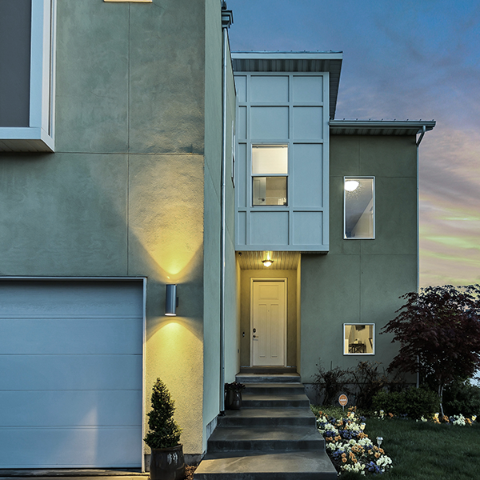
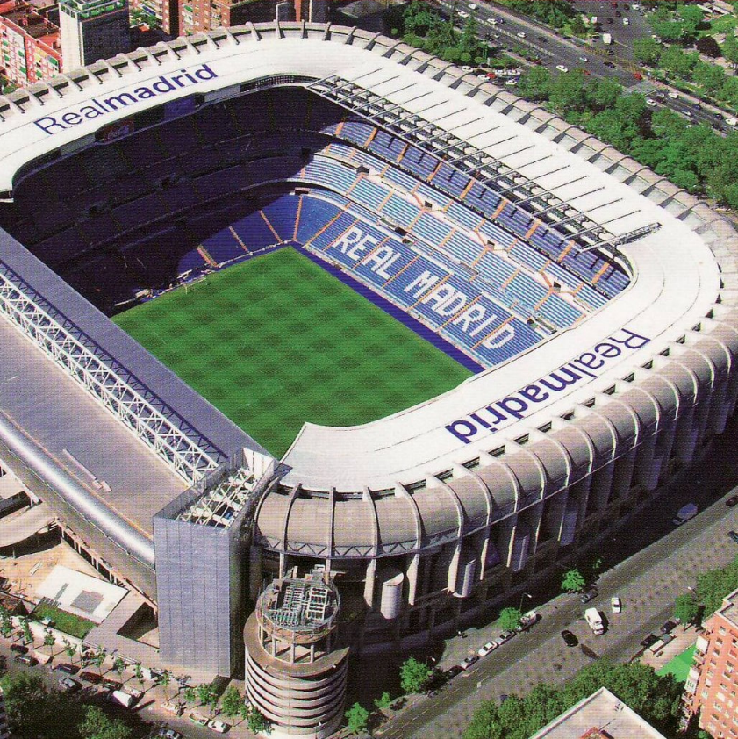

What are you building? Your cloud foundation supports the construction of a—
House
Stadium
Bridge

Slide 5
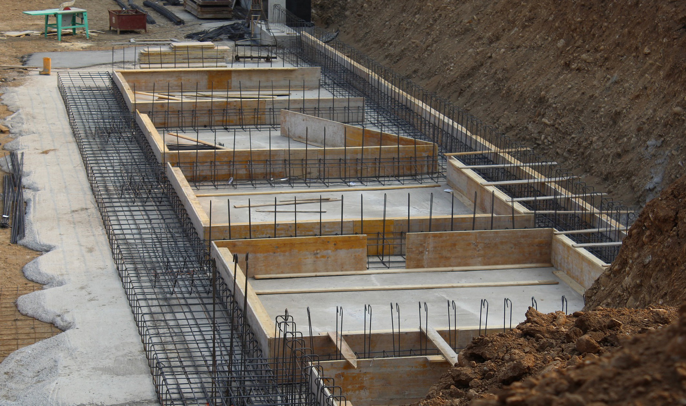
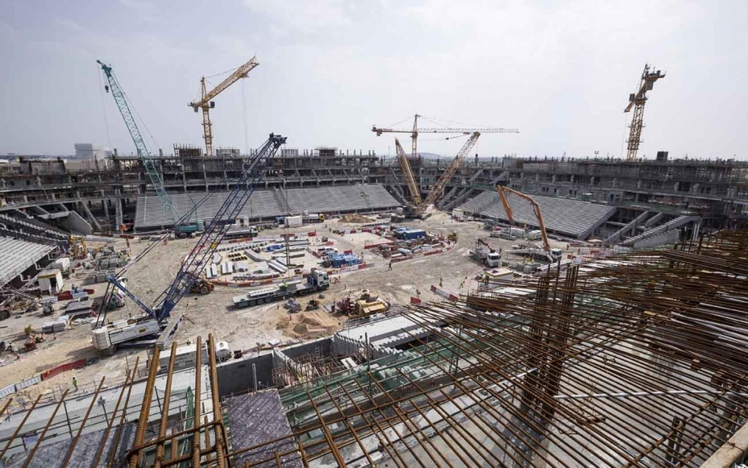
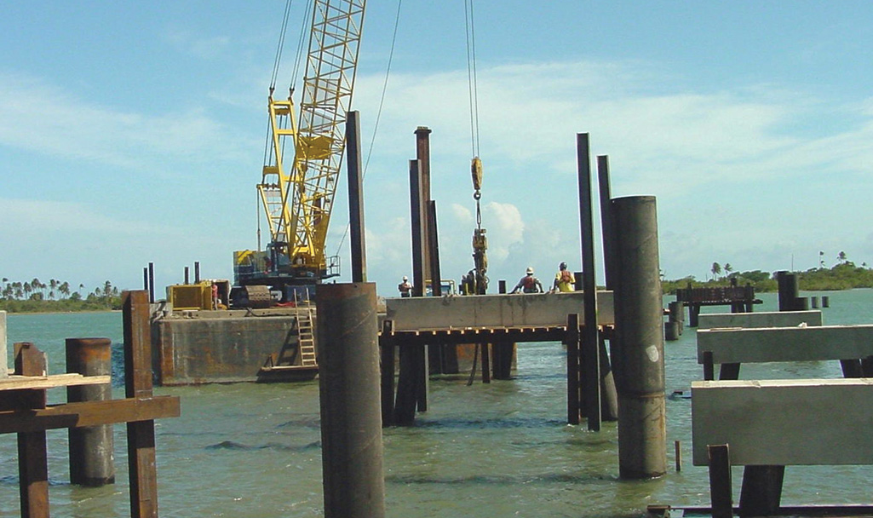
All foundations are NOT created equal
A house
A stadium
A bridge

Slide 6
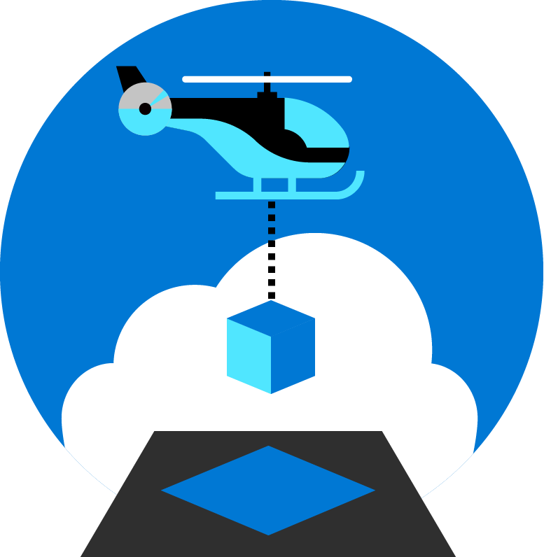
Azure landing zones
Set up Azure environments— for scale, security, governance, networking, and identity
Enable migrations and net new apps
Consider all platform resources
Don't differentiate between IaaS or PaaS
Notes:
Azure landing zones focus on unifying technologies and technical guidance to help you build a successful cloud environment.
In general, Azure landing zones:
Offer repeatable packaged environments
Enable migrations and net new apps.
Simplify the process of starting a cloud environment, to enable teams to focus on migration or innovation
Now, lets look in detail at what we consider to be the focus areas for a landing zone.

Slide 7





Azure landing zone Design Principles
Subscription Democratisation
Enable Autonomy for Innovation and Transformation
Security and Compliance By-Default
Governance At-Scale with Sustainable Cloud Engineering
Policy Driven Governance
Single Control and Management Plane
Application Centric and Archetype-Neutral
Azure Native Design and Platform Roadmap Alignment
Notes:
Just like organizing books in library (think of a book being a resource on a shelf in a cabinet in a room in the library) comes with set of principals (labelling, category). ALZ comes with set of design principals, which are necessary for organizing resources in subscriptions. These are (read out the 5 principles)
I’ll cover these principles in more detail in the following slides.
Subscriptions should be used as a unit of management and scale aligned with business needs and priorities. You should avoid to maintain central control for subscription creation, and allow business units to create subscriptions themselves. Your governance model should ensure that as subscriptions are created and moved to different management groups, policies are applied to enforce any necessary guardrails.
Azure Policy should be used to provide the “guard-rails” and ensure the continued compliance of the customer platform and applications deployed onto it, whilst also providing application owners sufficient freedom and a secure unhindered path to cloud.
The ALZ architecture should NOT rely on abstraction layers such as customer developed portals or tooling, and should provide a consistent experience for both AppOps (centrally managed operation teams) and DevOps (dedicated application operation teams).
The ALZ architecture should focus on application centric migrations and development rather than a pure infrastructure “lift and shift” migration (i.e. movement of virtual machines) and should not differentiate between old/new applications or IaaS/PaaS applications.
The ALZ architecture strongly advocates the use of native platform services and capabilities wherever possible, which should be fully aligned with Azure platform roadmaps from the offset to ensure new capabilities are swiftly made available within customer environments.
the use of native platform services and capabilities wherever possible, which should be fully aligned with Azure platform roadmaps from the offset to ensure new capabilities are swiftly made available within customer environments.

Slide 8

Azure landing zones Design areas
Azure billing & Azure Active Directory tenant
Security
Identity & access management
Governance
ENVIRONMENT
COMPLIANCE
Resource organization
Management
Network topology & connectivity
Platform automation & DevOps

Slide 9
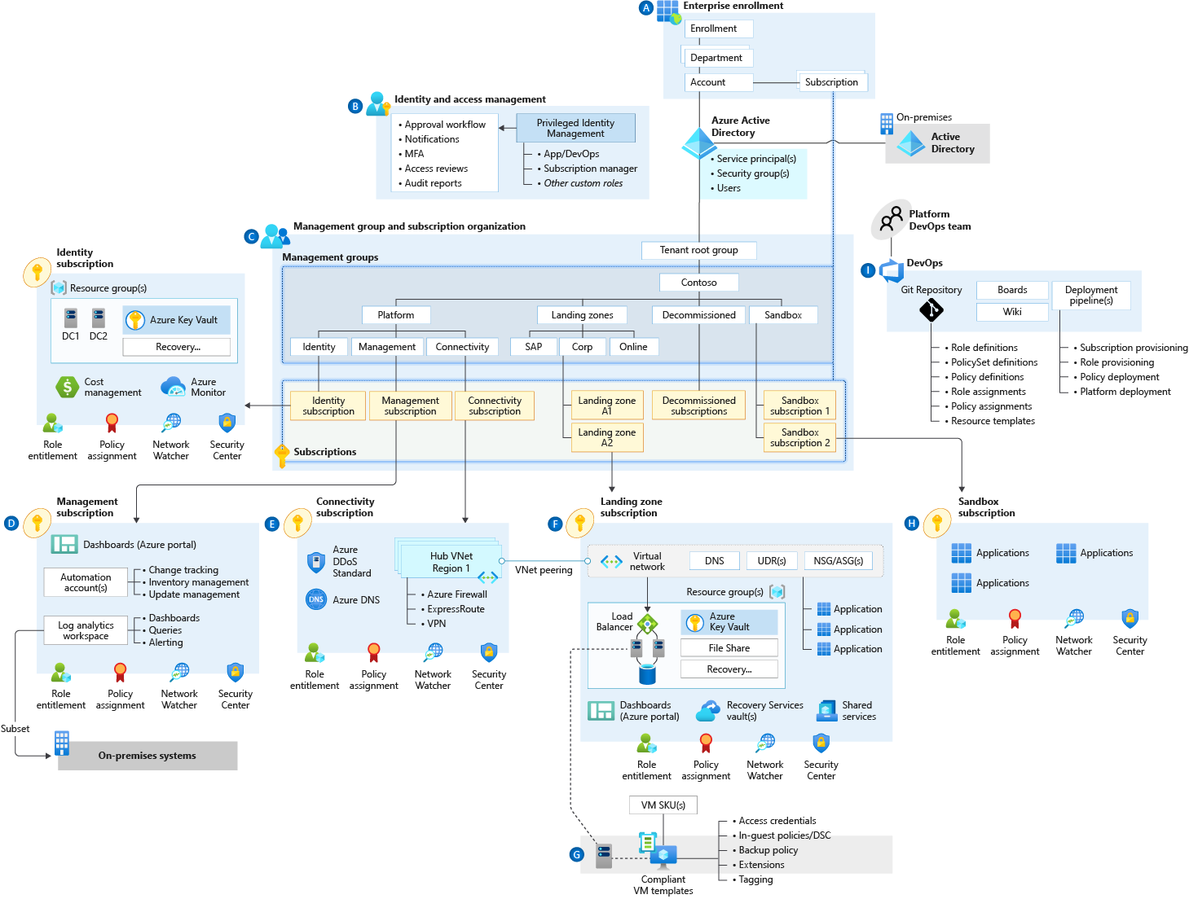
Azure landing zone conceptual architecture Contoso reference implementation
Target end-state for most organizations
Scaled-out and mature environment
Customer and partner practices for environment design across Microsoft
Strong foundation for management, governance, and security processes
Notes:
Azure landing zone conceptual architecture
The destination (or target end-state) of the journey.
Scaled-out controls and architecture to enable customers to grow and innovate safely
Depending on the cloud operating model chosen, you may arrive at this destination quickly, or over time.
This may represent a subset of your estate, if you scale into enterprise operations or distributed operations
We are learning from engagements with customers and partners, codifying best practices guidance for the cloud adoption journey.
Let's dive into common starting points, and the typical phases of a cloud journey.

Slide 10
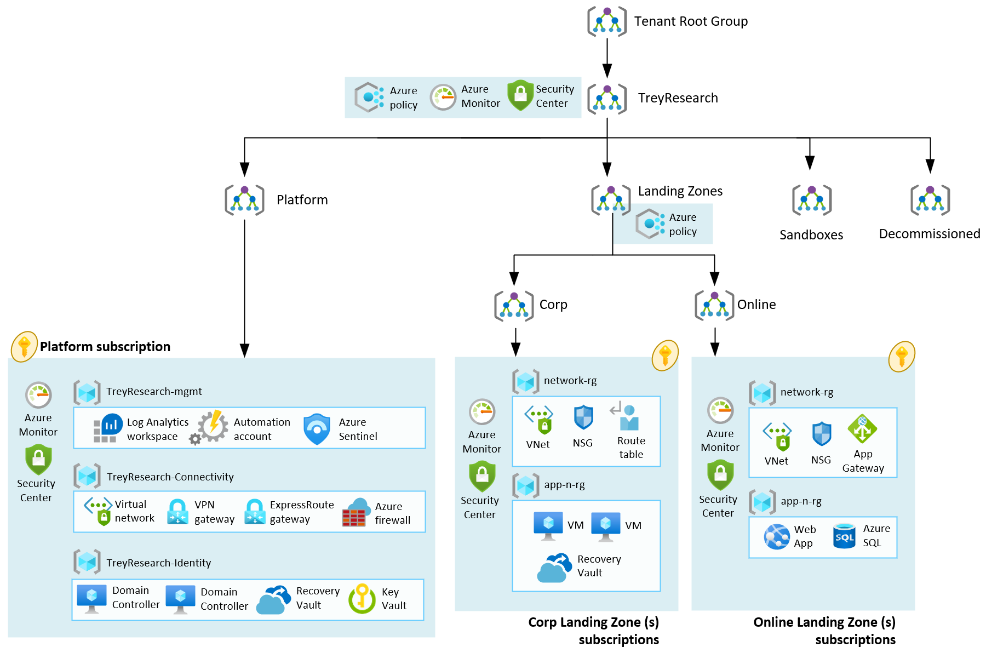
Azure landing zone conceptual architecture Trey Research Reference Implementation
Target end-state for most organizations
Can be scaled-out and mature if the business requirements change over time
Customer and partner practices for environment design across Microsoft
Strong foundation for management, governance, and security processes
Notes:
Azure landing zone conceptual architecture
The destination (or target end-state) of the journey.
Scaled-out controls and architecture to enable customers to grow and innovate safely
Depending on the cloud operating model chosen, you may arrive at this destination quickly, or over time.
This may represent a subset of your estate, if you scale into enterprise operations or distributed operations
We are learning from engagements with customers and partners, codifying best practices guidance for the cloud adoption journey.
Let's dive into common starting points, and the typical phases of a cloud journey.

Slide 11
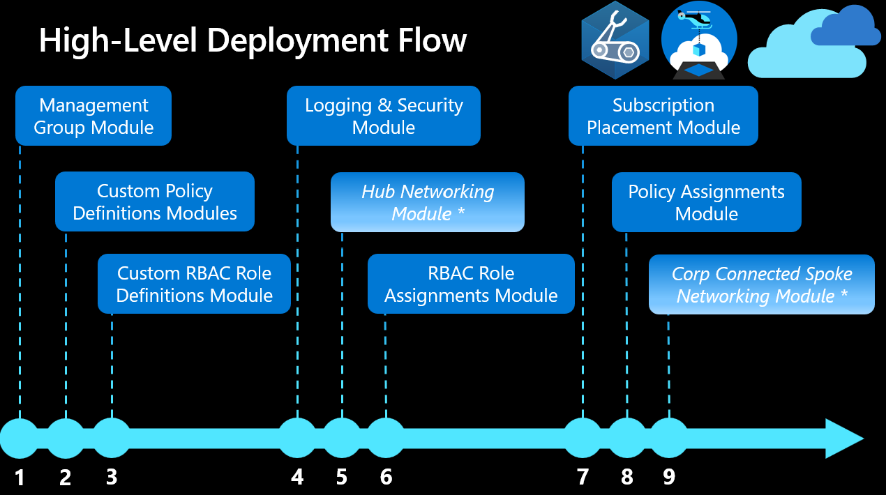
Azure landing zone conceptual architecture Bicep Reference Implementation
Order | Module | Description
1 | Management Groups | Configures the management group hierarchy to support Azure Landing Zone reference implementation.
2 | Custom Policy Definitions | Configures Custom Policy Definitions at the organization management group.
3 | Custom Role Definitions | Configures custom roles based on Cloud Adoption Framework's recommendations at the organization management group.
4 | Logging & Sentinel | Configures a centrally managed Log Analytics Workspace, Automation Account and Sentinel in the Logging subscription.
5 | Hub Networking | Azure supports two types of hub-and-spoke design, VNet hub and Virtual WAN hub. Creates resources in the Connectivity subscription.
6 | Role Assignments | Creates role assignments using built-in and custom role definitions.
7 | Subscription Placement | Moves one or more subscriptions (based on IDs) to the target Management Groups in your ALZ hierarchy.
8 | Built-In and Custom Policy Assignments | Creates policy assignments to provide governance at scale.
9 | Spoke Networking | Creates Spoke networking infrastructure for workloads with Virtual Network Peering (optional) to support Hub & Spoke network topology or Virtual Hub Connection (optional).
Notes:
In Azure Active Directory (Azure AD), part of Microsoft Entra, each Azure AD organization is fully independent: a peer that is logically independent from the other Azure AD organizations that you manage. This independence between organizations includes resource independence, administrative independence, and synchronization independence. There is no parent-child relationship between organizations.
If you create or delete an Azure AD resource in one organization, it has no impact on any resource in another organization, with the partial exception of external users.
If you register one of your domain names with one organization, it can't be used by any other organization.
Administrative independence
If a non-administrative user of organization 'Contoso' creates a test organization 'Test,' then:
By default, the user who creates a organization is added as an external user in that new organization, and assigned the global administrator role in that organization.
The administrators of organization 'Contoso' have no direct administrative privileges to organization 'Test,' unless an administrator of 'Test' specifically grants them these privileges. However, administrators of 'Contoso' can control access to organization 'Test' if they sign in to the user account that created 'Test.'
If you add or remove an Azure AD role for a user in one organization, the change does not affect the roles that the user is assigned in any other Azure AD organization.

Slide 12
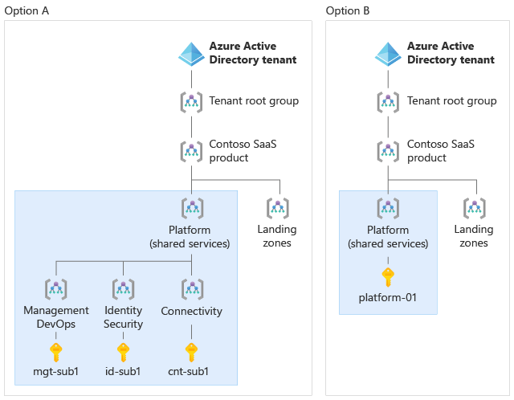
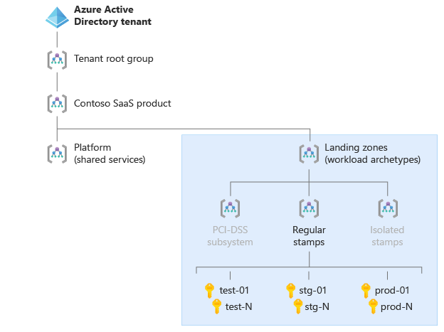
ISV considerations for Azure landing zones
Notes:
The Azure landing zones help you choose a direction for your overall Azure environment. But as an ISV, SaaS provider, or startup, your specific implementation needs might differ from more standard customer scenarios. The following are just a few different implementation scenario examples:
You build software that customers deploy into their own subscriptions.
You have your own control plane and use automation scripts or software to deploy and configure Azure resources for your SaaS solutions.
You're a small ISV or startup and want to start with the lowest possible cost, and might not want to initially use services like Azure Firewall and Azure DDoS Protection.
You're a large SaaS ISV and plan to split your SaaS application across multiple subscriptions for scale. You also want to group the subscriptions so they correspond to your development, test, staging, and production environments.
Your organization's operating model separates the roles of your corporate IT team and your SaaS product teams. Your organization's corporate IT team might manage resources like Microsoft Office 365 and Microsoft Teams, and your SaaS product team might be responsible for building and operating your SaaS product (including its central platform and identity components).

Slide 13
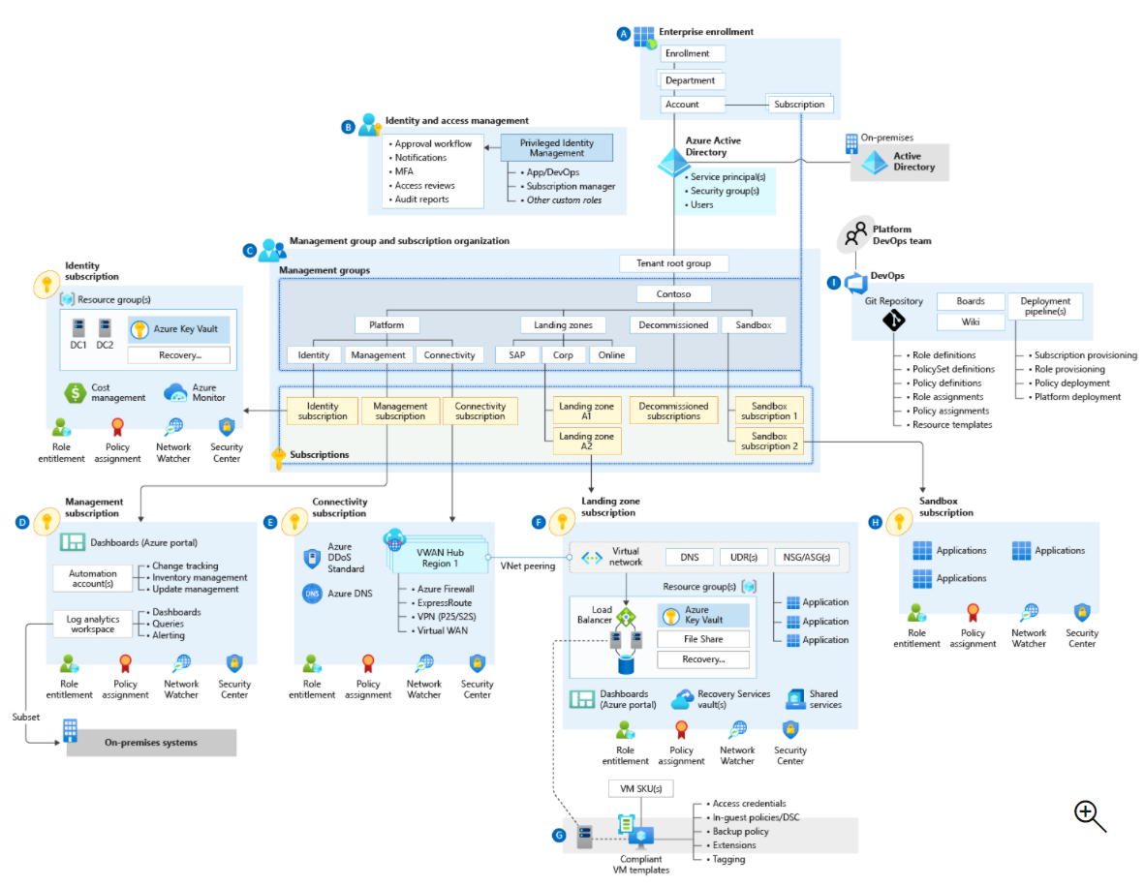
Common implementation approach
Target end-state:
Azure landing zones conceptual architecture
Check all boxes
Azure billing and AD tenant
Identity and access management
Network topology and connectivity
Resource organization
Governance
Management
Security
Platform automation and DevOps
Check few boxes
Check all boxes
Iterate and check
Small implementation
Notes:
Customers may take slightly different routes, but the end-goal should be the same.
With the target end-state in mind, we recommend a common, unified approach to landing zone implementation.
Progressing to the target end-state [Azure landing zones conceptual architecture]
All the onramps lead to the same freeway (ALZ conceptual architecture)
Your chosen design areas will affect your end-result, whether Start (greenfield development), Align (brownfield development involving refactoring), or Enhance (adding new controls or features to your environment).
Sometimes, organizations start down their own path – with a smaller subset of the design areas – and then look to bring their environment in closer alignment to the conceptual architecture.
This alignment drives towards the same outcome as if they’d taken one of the implementation options – and we’ll cover ALIGN a little later.

Slide 14
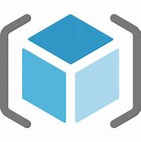

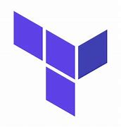
Azure landing zones – Implementation Options
Landing zone implementation options
Portal (ALZ Accelerator; fastest deployment option)
Bicep
Terraform
Portal
Bicep
Terraform
Notes:
Landing zone implementation options
https://docs.microsoft.com/en-us/azure/cloud-adoption-framework/ready/landing-zone/implementation-options
Implementation Options:
Portal - Azure landing zone accelerator
Bicep - modular approach
Terraform – Popular OSS tool

Slide 15
Design Areas

Slide 16
Azure landing zones Design areas
Azure billing & Azure Active Directory tenant
Security
Identity & access management
Governance
ENVIRONMENT
COMPLIANCE
Resource organization
Management
Network topology & connectivity
Platform automation & DevOps

Slide 17
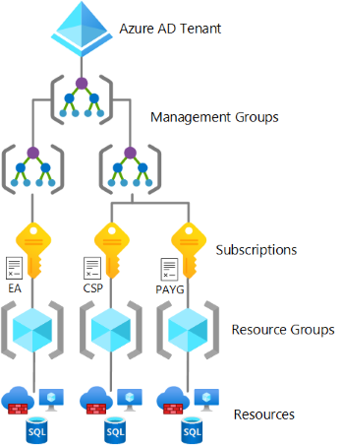

This critical design area focuses on the two highest levels of alignment across all of your Azure deployments; your Azure billing offer and the association of that offer with an Azure Active Directory (Azure AD) tenant.
Azure billing &
AAD Tenant

Slide 18
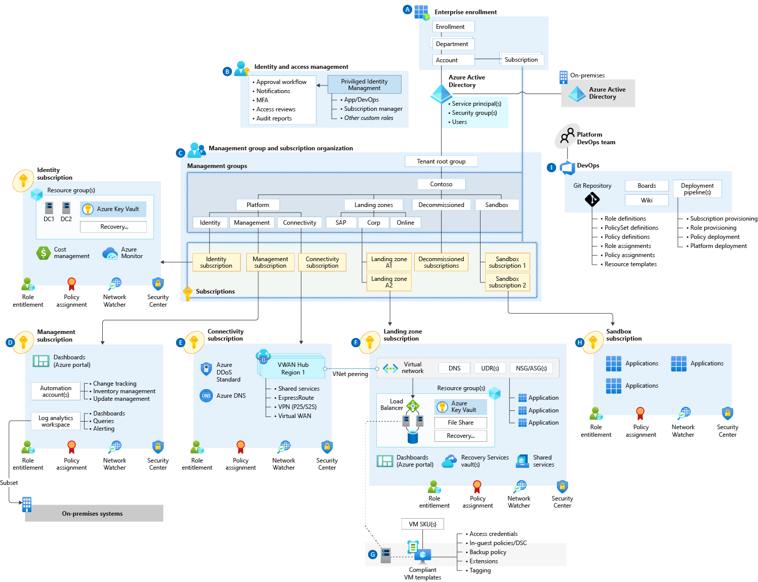

Identity & Access Management
This critical design area establishes a foundation for the management of identity and access.

Slide 19

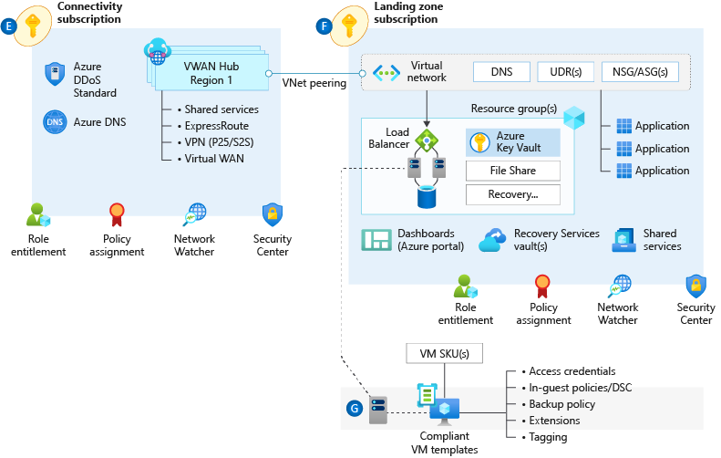
Network Topology & Connectivity
The network topology and connectivity design area is critical for establishing a foundation for your cloud network design.

Slide 20
Resource Organization
The critical resource organization design area establishes consistent patterns for organizing resources deployed to the cloud.

Slide 21
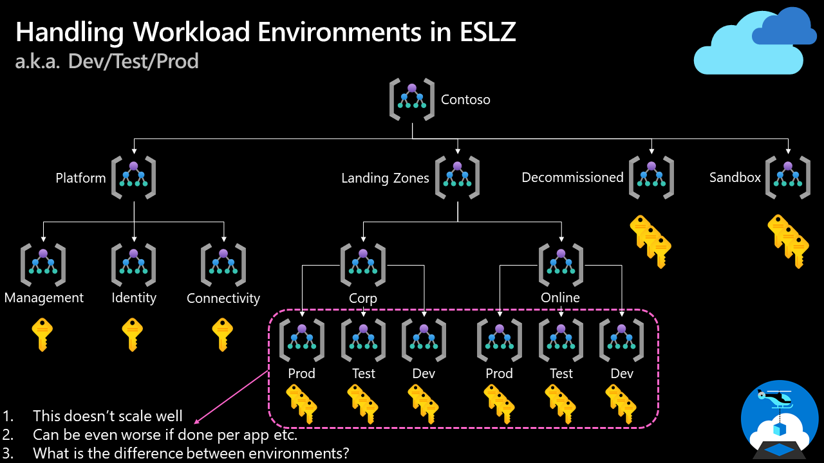
How do we handle "dev/test/production" workload landing zones in enterprise-scale architecture?

Slide 22
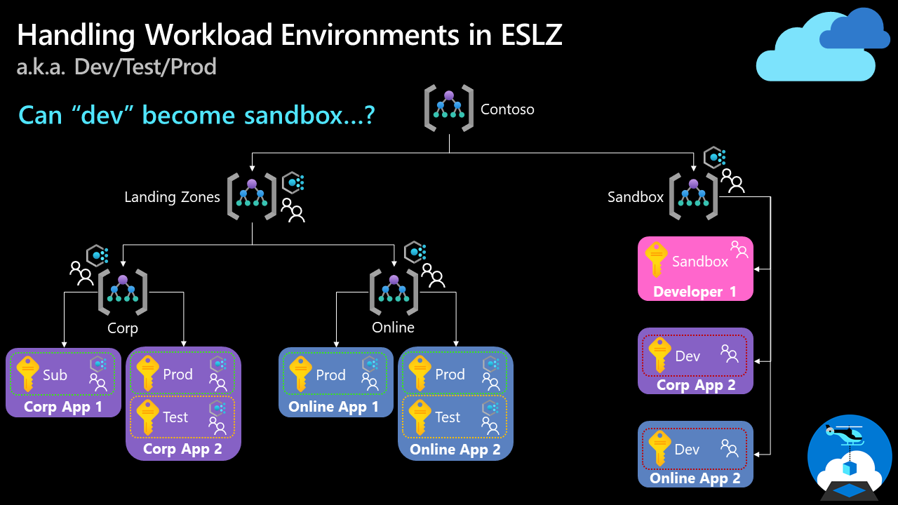
How do we handle "dev/test/production" workload landing zones in enterprise-scale architecture?
Note: We discussed this topic in our enterprise-scale community call in August 2021. You can find the recording on YouTube.

Slide 23

Security
This design area creates a foundation for security across your Azure, hybrid, and multicloud environments.
You can enhance this foundation later with security guidance outlined in the Cloud Adoption Framework's Secure methodology.

Slide 24
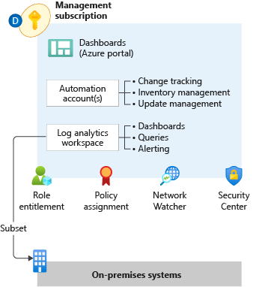

Management
This design area establishes a foundation for operations management across your Azure, hybrid, or multicloud environments.

Slide 25

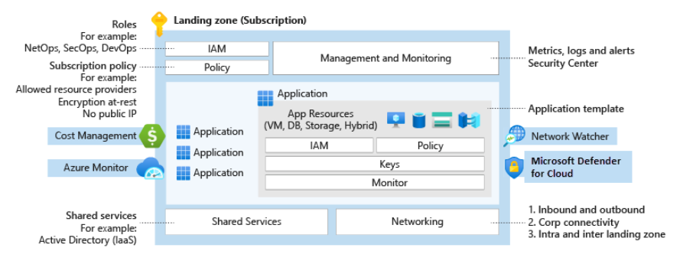
Governance
Azure governance establishes the tooling needed to support cloud governance, compliance auditing, and automated guardrails.
Governance provides mechanisms and processes for maintaining control over platforms, applications, and resources in Azure.

Slide 26
Platform Automation & DevOps
Platform automation and DevOps evaluate opportunities to modernize your approach to environmental deployment with infrastructure as code options.

Slide 27
Resources & Next Steps

Slide 28
Azure Landing Zones Resources
Complete the MS Learning Path: Create an Enterprise-Scale Architecture on Azure
Review the Azure landing zone Architecture guidance
Explore the Azure landing zone Implementation options
Share your Feedback!
New Azure Landing Zones Survey
https://aka.ms/alz/survey
Issues on Github
https://aka.ms/enterprisescale https://aka.ms/alz/bicep
https://aka.ms/alz/tf

Slide 29
Thank you!

